Slide 1
Software Risk Management :
Overview and Recent Developments
Barry Boehm, USC
CS 510, CS 577a
Fall,2005
(boehm@sunset.usc.edu)
(http://sunset.usc.edu)

Slide 2
Outline
What is Software Risk Management?
What can it help you do?
When should you do it?
How should you do it?
What are its new trends and opportunities?
Conclusions
Top-10 Risk Survey
10/14/05
©USC-CSE

Slide 3
Is This A Risk?
We just started integrating the software
  and we found out that COTS* products A and B just can’t talk to each other
We’ve got too much tied into A and B to change
Our best solution is to build wrappers around A and B to get them to talk via CORBA**
This will take 3 months and $300K
It will also delay integration and delivery by at least 3 months
*COTS: Commercial off-the-shelf
**CORBA: Common Object Request Broker Architecture
10/14/05
©USC-CSE

Slide 4
Is This A Risk?
We just started integrating the software
  and we found out that COTS* products A and B just can’t talk to each other
We’ve got too much tied into A and B to change
*******
No, it is a problem
  Being dealt with reactively
Risks involve uncertainties
  And can be dealt with pro-actively
  Earlier, this problem was a risk
10/14/05
©USC-CSE

Slide 5
Earlier, This Problem Was A Risk
A and B are our strongest COTS choices
  But there is some chance that they can’t talk to each other
  Probability of loss P(L)
If we commit to using A and B
  And we find out in integration that they can’t talk to each other
  We’ll add more cost and delay delivery by at least 3 months
  Size of loss S(L)
We have a risk exposure of
        RE = P(L) * S(L)
10/14/05
©USC-CSE

Slide 6
How Can Risk Management Help You Deal With Risks?
Buying information
Risk avoidance
Risk transfer
Risk reduction
Risk acceptance
10/14/05
©USC-CSE

Slide 7
Risk Management Strategies:
Buying Information
Let’s spend $30K and 2 weeks prototyping the integration of A and B
This will buy information on the magnitude of P(L) and S(L)
If RE = P(L) * S(L) is small, we’ll accept and monitor the risk
If RE is large, we’ll use one/some of the other strategies
10/14/05
©USC-CSE

Slide 8
Other Risk Management Strategies
Risk Avoidance
  COTS product C is almost as good as B, and it can talk to A
  Delivering on time is worth more to the customer than the small performance loss
Risk Transfers
  If the customer insists on using A and B, have them establish a risk reserve.
  To be used to the extent that A and B can’t talk to each other
Risk Reduction
  If we build the wrappers and the CORBA corrections right now, we add cost but minimize the schedule delay
Risk Acceptance
  If we can solve the A and B interoperability problem, we’ll have a big competitive edge on the future procurements
  Let’s do this on our own money, and patent the solution
10/14/05
©USC-CSE

Slide 9
Is Risk Management Fundamentally Negative?
It usually is, but it shouldn’t be
As illustrated in the Risk Acceptance strategy, it is equivalent to Opportunity Management
Opportunity Exposure OE = P(Gain) * S(Gain) = Expected Value
Buying information and the other Risk Strategies have their Opportunity counterparts
  P(Gain): Are we likely to get there before the competition?
  S(Gain): How big is the market for the solution?
10/14/05
©USC-CSE

Slide 10
What Else Can Risk Risk Management Help You Do?
Determine “How much is enough?” for your products and processes
  Functionality, documentation, prototyping, COTS evaluation, architecting, testing, formal methods, agility, discipline, …
  What’s the risk exposure of doing too much?
  What’s the risk exposure of doing too little?
Tailor and adapt your life cycle processes
  Determine what to do next (specify, prototype, COTS evaluation, business case analysis)
  Determine how much of it is enough
  Examples: Risk-driven spiral model and extensions (win-win, anchor points, RUP, MBASE, CeBASE Method)
Get help from higher management
  Organize management reviews around top-10 risks
10/14/05
©USC-CSE

Slide 11
Outline
What is Software Risk Management?
What can it help you do?
When should you do it?
How should you do it?
What are its new trends and opportunities?
Conclusions
Top-10 Risk Survey
10/14/05
©USC-CSE

Slide 12
Risk Management Starts on Day One
Early and Late Risk Resolution
  Quotes, Notes, and Data
  Temptations to Avoid
Early Risk Resolution with the WinWin Spiral Model
  Identifying Stakeholders and Win Conditions
  Model Clash and Win-Lose Risk Avoidance
  Avoiding Cost/Schedule Risks with the SAIV Model
10/14/05
©USC-CSE

Slide 13
Early Risk Resolution Quotes
“In architecting a new software program, all the serious mistakes are made on the first day.”
Robert Spinrad, VP-Xerox, 1988
“If you don’t actively attack the risks, the risks will actively attack you.”
Tom Gilb, 1988
10/14/05
©USC-CSE

Slide 14
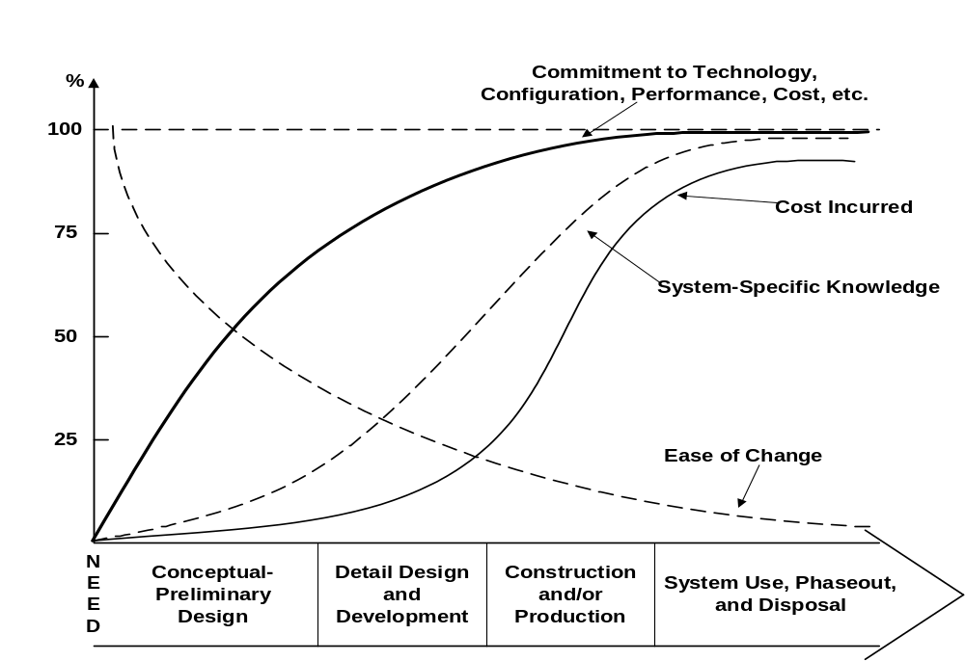
Risk of Delaying Risk Management: Systems
Blanchard- Fabrycky, 1998

Slide 15
Risk of Delaying Risk Management: Software
1000
Larger software projects
500
IBM-SSD
200
GTE
100
80%
Relative cost to fix defect
Median (TRW survey)
50
20%
SAFEGUARD
20
10
Smaller software projects
5
2
1
Requirements Design Code Development Acceptance Operation
test test
Phase in Which defect was fixed
10/14/05
©USC-CSE

Slide 16
Steeper Cost-to-fix for High-Risk Elements
100
TRW Project B
1005 SPR’s
90
80
TRW Project A
373 SPR’s
70
% of
Cost
to
Fix
SPR’s
60
50
Major Rework Sources:
Off-Nominal Architecture-Breakers
A - Network Failover
B - Extra-Long Messages
40
30
20
10
0
0
10
20
30
40
50
60
70
80
90
100
% of Software Problem Reports (SPR’s)
10/14/05
©USC-CSE

Slide 17
Day One Temptations to Avoid - I
It’s too early to think about risks. We need to:
  Finalize the requirements
  Maximize our piece of the pie
  Converge on the risk management organization, forms, tools, and procedures. Don’t put the cart before the horse.
The real horse is the risks, and it’s leaving the barn
  Don’t sit around laying out the seats on the cart
  while this happens. Work this concurrently.
10/14/05
©USC-CSE

Slide 18
Day One Temptations to Avoid - II
We don’t have time to think about the risks. We need to:
  Get some code running right away
  Put on a socko demo for the customers
  Be decisive. Lead. Make commitments.
The Contrarian’s Guide to Leadership (Sample, 2002)
  Never make a decision today that can be put off till tomorrow.
  Don’t form opinions if you don’t have to. Think gray.
10/14/05
©USC-CSE

Slide 19
Day One Temptations to Avoid - III
Unwillingness to admit risks exist
  Leaves impression that you don’t know exactly what you’re doing
  Leaves impression that your bosses, customers don’t know exactly what they’re doing
  “Success-orientation”
  “Shoot the messenger” syndrome
Tendency to postpone the hard parts
  Maybe they’ll go away
  Maybe they’ll get easier, once we do the easy parts
Unwillingness to invest money and time up front
10/14/05
©USC-CSE

Slide 20
Outline
What is Software Risk Management?
What can it help you do?
When should you do it?
How should you do it?
What are its new trends and opportunities?
Conclusions
Top-10 Risk Survey
10/14/05
©USC-CSE

Slide 21
Software Risk Management
Risk
Identification
Checklists
Decision driver analysis
Assumption analysis
Decomposition
Risk
Assessment
Risk
Analysis
Performance models
Cost models
Network analysis
Decision analysis
Quality factor analysis
Risk
Prioritization
Risk exposure
Risk leverage
Compound risk reduction
Risk
Management
Risk mgmt
Planning
Buying information
Risk avoidance
Risk transfer
Risk reduction
Risk element planning
Risk plan integration
Risk
Control
Risk
Resolution
Prototypes
Simulations
Benchmarks
Analyses
Staffing
Risk
Monitoring
Milestone tracking
Top-10 tracking
Risk reassessment
Corrective action
10/14/05
©USC-CSE

Slide 22
Risk Identification Techniques
Risk-item checklists
Decision driver analysis
  Comparison with experience
  Win-lose, lose-lose situations
Decomposition
  Pareto 80 – 20 phenomena
  Task dependencies
  Murphy’s law
  Uncertainty areas
Model Clashes
10/14/05
©USC-CSE

Slide 23
Top 10 Risk Items: 1989 and 1995
1989
1995
Personnel shortfalls
Schedules and budgets
Wrong software functions
Wrong user interface
Gold plating
Requirements changes
Externally-furnished components
Externally-performed tasks
Real-time performance
Straining computer science
Personnel shortfalls
Schedules, budgets, process
COTS, external components
Requirements mismatch
User interface mismatch
Architecture, performance, quality
Requirements changes
Legacy software
Externally-performed tasks
Straining computer science
10/14/05
©USC-CSE

Slide 24
Example Risk-item Checklist: Staffing
Will you project really get all the best people?
Are there critical skills for which nobody is identified?
Are there pressures to staff with available warm bodies?
Are there pressures to overstaff in the early phases?
Are the key project people compatible?
Do they have realistic expectations about their project job?
Do their strengths match their assignment?
Are they committed full-time?
Are their task prerequisites (training, clearances, etc.) Satisfied?
10/14/05
©USC-CSE

Slide 25
Risk ID: Examining Decision Drivers
Political versus Technical
  Choice of equipment
  Choice of subcontractor
  Schedule, Budget
  Allocation of responsibilities
Marketing versus Technical
  Gold plating
  Choice of equipment
  Schedule, budget
Solution-driven versus Problem-driven
  In-house components, tools
  Artificial intelligence
  Schedule, Budget
Short-term versus Long-term
  Staffing availability versus qualification
  Reused software productions engineering
  Premature SRR, PDR
Outdated Experience
10/14/05
©USC-CSE

Slide 26
Potential Win-lose, Lose-lose Situations
“Winner”
Loser
Quick, cheap, sloppy product
Lots of bells and whistles
Driving too hard a bargain
Developer
Customer
User
Developer
Customer
Customer
Developer
Customer
Developer
Actually, nobody wins in these situations
10/14/05
©USC-CSE

Slide 27
Watch Out For Compound Risks
Pushing technology on more than one front
Pushing technology with key staff shortages
Vague user requirements with ambitious schedule
Untried hardware with ambitious schedule
Unstable interfaces with untried subcontractor
Reduce to non-compound risks if possible
Otherwise, devote extra attention to
  compound- risk containment
10/14/05
©USC-CSE

Slide 28
The Top Ten Software Risk Items
Risk Item
Risk Management Techniques
1. Personnel Shortfalls
Staffing with top talent; key personnel
agreements; incentives; team-building; training;
tailoring process to skill mix; peer reviews
2. Unrealistic schedules
and budgets
Business case analysis; design to cost; incremental
development; software reuse; requirements descoping;
adding more budget and schedule
3. COTS; external components
Qualification testing; benchmarking; prototyping; reference checking; compatibility analysis; vendor analysis; evolution support analysis
4. Requirements mismatch;
gold plating
Stakeholder win-win negotiation; business case
analysis; mission analysis; ops-concept formulation;
user surveys; prototyping; early users’ manual;
design/develop to cost
5. User interface mismatch
Prototyping; scenarios; user characterization
(functionality, style, workload)
10/14/05
©USC-CSE

Slide 29
The Top Ten Software Risk Items (Concluded)
6. Architecture, performance,
quality
Architecture tradeoff analysis and review boards;
simulation; benchmarking; modeling; prototyping;
instrumentation; tuning
7. Requirements changes
High change threshold; information
hiding; incremental development (defer
changes to later increments)
8. Legacy software
Design recovery; phaseout options analysis;
wrappers/mediators; restructuring
9. Externally-performed
tasks
Reference checking; pre-award audits;
award-fee contracts; competitive design
or prototyping; team-building
10. Straining Computer
Science capabilities
Technical analysis; cost-benefit analysis;
prototyping; reference checking
10/14/05
©USC-CSE

Slide 30
Network Schedule Risk Analysis
2, p = 0.5
6, p = 0.5
2, p = 0.5
6, p = 0.5
4 months
. . .
. . .
. . .
. . .
4
4 Equally Likely Outcomes
EV = 4 months
2
2
2
2
6
_20_
4
6
EV =
= 5 MONTHS
6
2
6
6
6
_6_
20
10/14/05
©USC-CSE

Slide 31
Prioritizing Risks: Risk Exposure
Risk Exposure - (Probability) (Loss of Utility)
High
Check
Utility -
Loss Estimate
Major
Risk
Risk Probability
Check
Probability
Estimate
Little
Risk
Low
Low
High
10/14/05
Loss of Utility
©USC-CSE

Slide 32
Risk Exposure Factors
(Satellite Experiment Software)
Unsatisfactory Outcome (UO)
Prob (UO)
Loss (UO)
Risk Exposure
3 - 5
3 - 5
4 - 8
5
5
6
8
6
1
2
10
8
7
9
3
4
1
5
7
2
30 - 50
24 - 40
28 - 56
45
15
24
8
30
7
4
A. S/ W error kills experiment
B. S/ W error loses key data
C. Fault tolerance features cause unacceptable
performance
D. Monitoring software reports unsafe condition
as safe
E. Monitoring software reports safe condition
as unsafe
F. Hardware delay causes schedule overrun
G. Data reduction software errors cause extra
work
H. Poor user interface causes inefficient
operation
I. Processor memory insufficient
J. DBMS software loses derived data
10/14/05
©USC-CSE

Slide 33
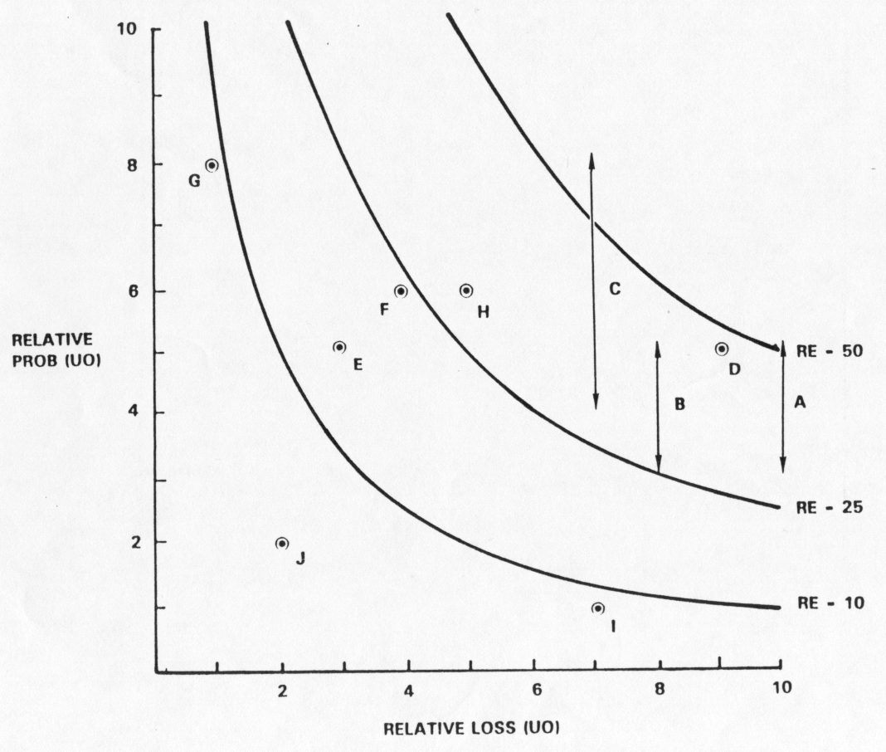
Risk Exposure Factors and Contours: Satellite Experiment Software
10/14/05
©USC-CSE

Slide 34
Risk Reduction Leverage (RRL)
RRL -
RE
BEFORE -
RE
AFTER
RISK REDUCTION COST
Spacecraft Example
LONG DURATION
TEST
FAILURE MODE
TESTS
LOSS (UO)
PROB (UO)
RE
$20M
0.2
$4M
$20M
0.2
$4M
B
B
PROB (UO)
RE
0.05
$1M
0.07
$1.4M
A
A
COST
$2M
$0.26M
4-1
4- 1.4
RRL
= 1.5
= 10
2
0.26
10/14/05
©USC-CSE

Slide 35
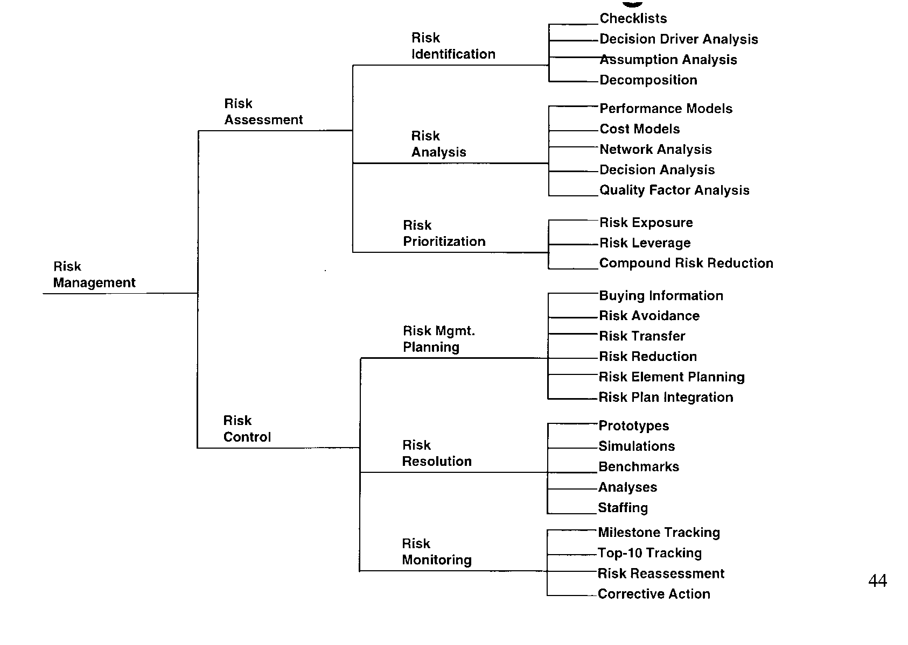
Software Risk Management
10/14/05
©USC-CSE

Slide 36
Risk Management Plans
For Each Risk Item, Answer the Following Questions:
1. Why?
Risk Item Importance, Relation to Project Objectives
2. What, When?
Risk Resolution Deliverables, Milestones, Activity Nets
3. Who, Where?
Responsibilities, Organization
4. How?
Approach (Prototypes, Surveys, Models, …)
5. How Much?
Resources (Budget, Schedule, Key Personnel)
10/14/05
©USC-CSE

Slide 37
Risk Management Plan: Fault Tolerance Prototyping
1. Objectives (The “Why”)
  Determine, reduce level of risk of the software fault tolerance features causing unacceptable performance
  Create a description of and a development plan for a set of low-risk fault tolerance features
2. Deliverables and Milestones (The “What” and “When”)
  By week 3
    1. Evaluation of fault tolerance option
    2. Assessment of reusable components
    3. Draft workload characterization
    4. Evaluation plan for prototype exercise
    5. Description of prototype
  By week 7
    6. Operational prototype with key fault tolerance features
    7. Workload simulation
    8. Instrumentation and data reduction capabilities
    9. Draft Description, plan for fault tolerance features
  By week 10
    10. Evaluation and iteration of prototype
    11. Revised description, plan for fault tolerance features
10/14/05
©USC-CSE

Slide 38
Risk Management Plan: Fault Tolerance Prototyping (concluded)
Responsibilities (The “Who” and “Where”)
  System Engineer: G. Smith
    Tasks 1, 3, 4, 9, 11, support of tasks 5, 10
  Lead Programmer: C. Lee
    Tasks 5, 6, 7, 10 support of tasks 1, 3
  Programmer: J. Wilson
    Tasks 2, 8, support of tasks 5, 6, 7, 10
Approach (The “How”)
  Design-to-Schedule prototyping effort
  Driven by hypotheses about fault tolerance-performance effects
  Use real-time OS, add prototype fault tolerance features
  Evaluate performance with respect to representative workload
  Refine Prototype based on results observed
Resources (The “How Much”)
  $60K - Full-time system engineer, lead programmer, programmer (10 weeks)*(3 staff)*($2K/staff-week)
  $0K - 3 Dedicated workstations (from project pool)
  $0K - 2 Target processors (from project pool)
  $0K - 1 Test co-processor (from project pool)
  $10K - Contingencies
  $70K - Total
10/14/05
©USC-CSE

Slide 39
Risk Monitoring
Milestone Tracking
  Monitoring of risk Management Plan Milestones
Top-10 Risk Item Tracking
  Identify Top-10 risk items
  Highlight these in monthly project reviews
  Focus on new entries, slow-progress items
  Focus review on manger-priority items
Risk Reassessment
Corrective Action
10/14/05
©USC-CSE

Slide 40
Project Top 10 Risk Item List: Satellite Experiment Software
Mo. Ranking
This Last #Mo.
Risk Item
Risk Resolution Progress
Replacing Sensor-Control Software 1 4 2 Top Replacement Candidate Unavailable
Developer
Target Hardware Delivery Delays 2 5 2 Procurement Procedural Delays
Sensor Data Formats Undefined 3 3 3 Action Items to Software, Sensor Teams;
Due Next Month
Staffing of Design V&V Team 4 2 3 Key Reviewers Committed; Need Fault-
Tolerance Reviewer
Software Fault-Tolerance May 5 1 3 Fault Tolerance Prototype Successful
Compromise Performance
Accommodate Changes in Data 6 - 1 Meeting Scheduled With Data Bus
Bus Design Designers
Testbed Interface Definitions 7 8 3 Some Delays in Action Items; Review
Meeting Scheduled
User Interface Uncertainties 8 6 3 User Interface Prototype Successful
TBDs In Experiment Operational - 7 3 TBDs Resolved
Concept
Uncertainties In Reusable - 9 3 Required Design Changes Small,
Monitoring Software Successfully Made
10/14/05
©USC-CSE

Slide 41
Conclusions
Risk management starts on Day One
  Delay and denial are serious career risks
  Data provided to support early investment
Win Win spiral model provides process framework for early risk resolution
  Stakeholder identification and win condition reconciliation
  Anchor point milestones
Risk analysis helps determine “how much is enough”
  Testing, planning, specifying, prototyping,…
  Buying information to reduce risk
10/14/05
©USC-CSE

